Slide 1





OSAP RECIPIENT MEETING
February 27, 2018
Notes:
OPIOID ADVISORY COMMITTEE
February 9, 2018

Slide 2
Introduction
Lynn Pitcher Komer
PK Public Relations
Cause Marketing
Collaborative Approach

Slide 3
What we are doing
STR - Anyone at Risk for Overdose
Adapt & Expand ADOR campaign to promote a mix of PR, Social Media, Website and outreach about opioid misuse prevention, treatment and recovery services
Build upon PDO and SPF Rx activities
Amended to provide provide Spanish website translation & social media enhancements based on the SPF Rx for education and information resources across the continuum of care. Amended to include naloxone training video.
PDO - High-risk counties (Bernalillo, Santa Fe, Rio Arriba and some statewide)
Provide PR and enhance Social Media on:
Naloxone education, access and recognizing signs of overdose (including overdose prevention)
Reduce stigma/discrimination
Treatment and recovery services
Amended for training video.
SPF Rx - Social Media
SAMHSA online apps (OpiRescue - overdose toolkit on phone)
Real-life stories
Engage with social media influencers
Notes:
Lesson learned is that outreach components must be aligned not by contract but by real life audience use. Total Budget $109,470 for ad buy Included social media advertising dollars of $3000 (not from Esparza budget)

Slide 4
Key Requirements of Grants
Leverage existing A Dose of Reality work (logo-look-tone-feel)
All campaigns to include A Dose of Reality BRANDING
Drive people to DoseOfRealityNM.com
Ensure consistent messaging

Slide 5
Why Reinvent the Wheel?
Approved Messages
Updated Facts/Data
Community Website
Parent handbook
Social Media Content, including posts, videos and still photography
Cross-market to increase your reach
Video ads
Print ads
Bus wrap ads
Infographics
Radio ads
Digital ads
Bookmarks & business cards
Notes:
All messages, including social media posts, have been vetted and approved to ensure they meet SAMHSA requirements and avoid stigma language. Meet SAMHSA and OSAP guidelines, which you must follow.

Slide 6
Campaign Evolution

Slide 7
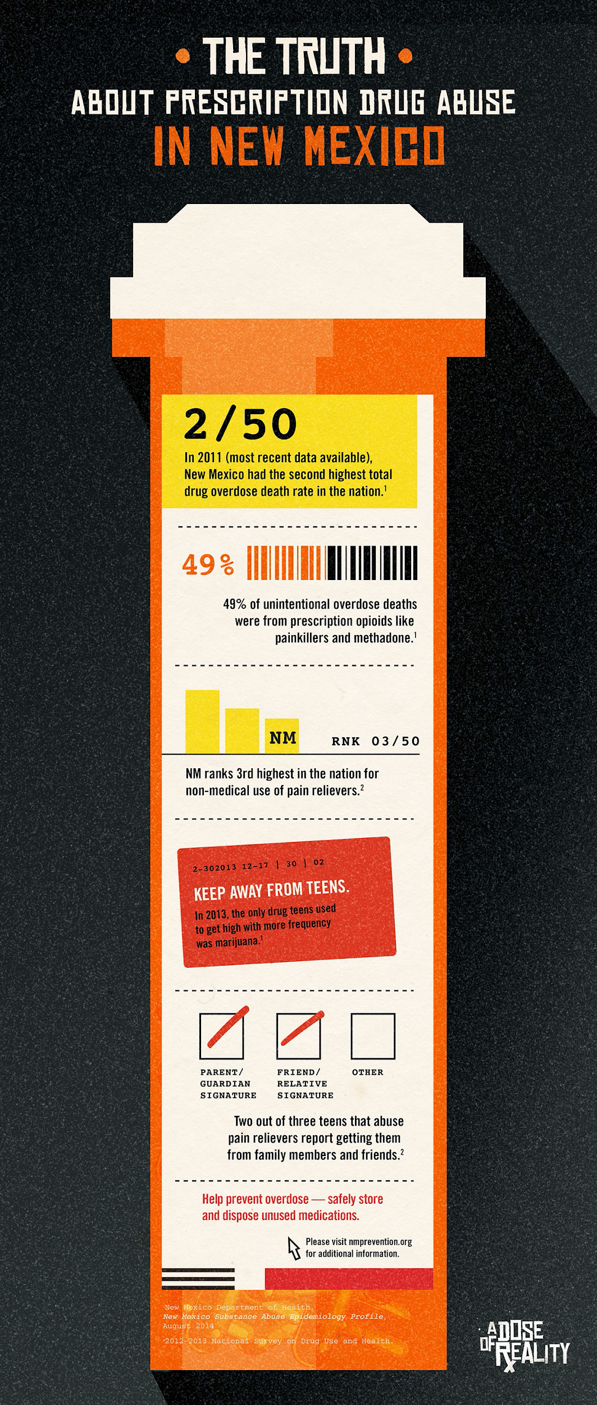
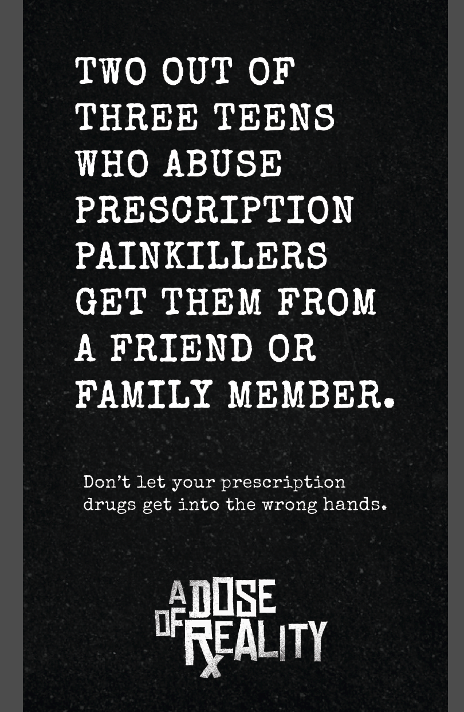
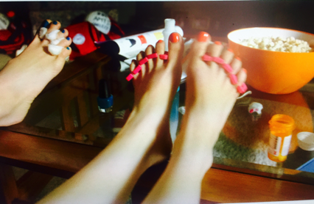
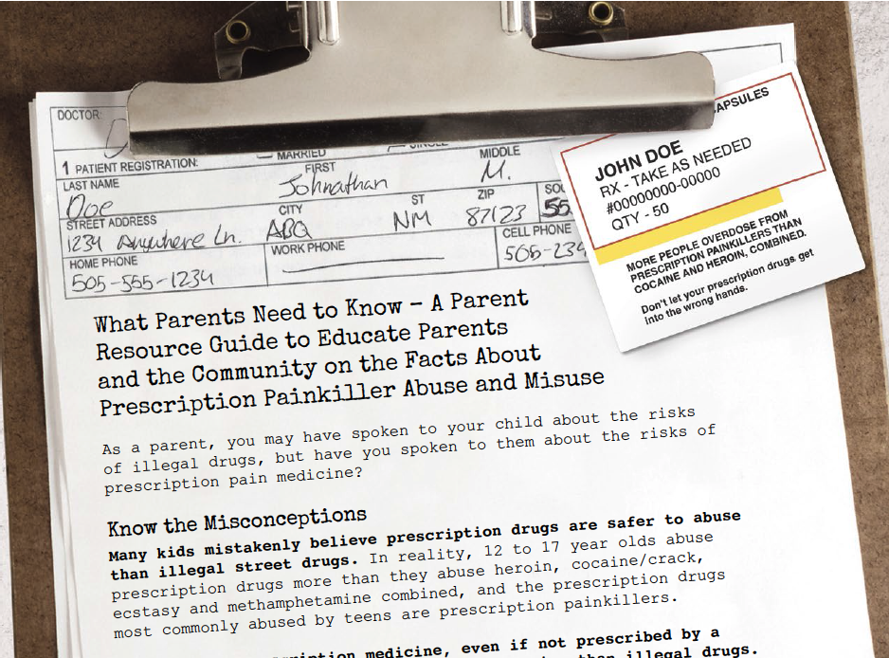
Teens
Video (ads, social media, presentations)
Notes:
The first campaign focused on awareness of the dangers of painkillers and also on dispelling myths teens had surrounding opioids (safe if prescribed by doctor, etc.) Video for sharing as either advertising or social media or in community presentations. Infographics, parent resource kit, etc.

Slide 8
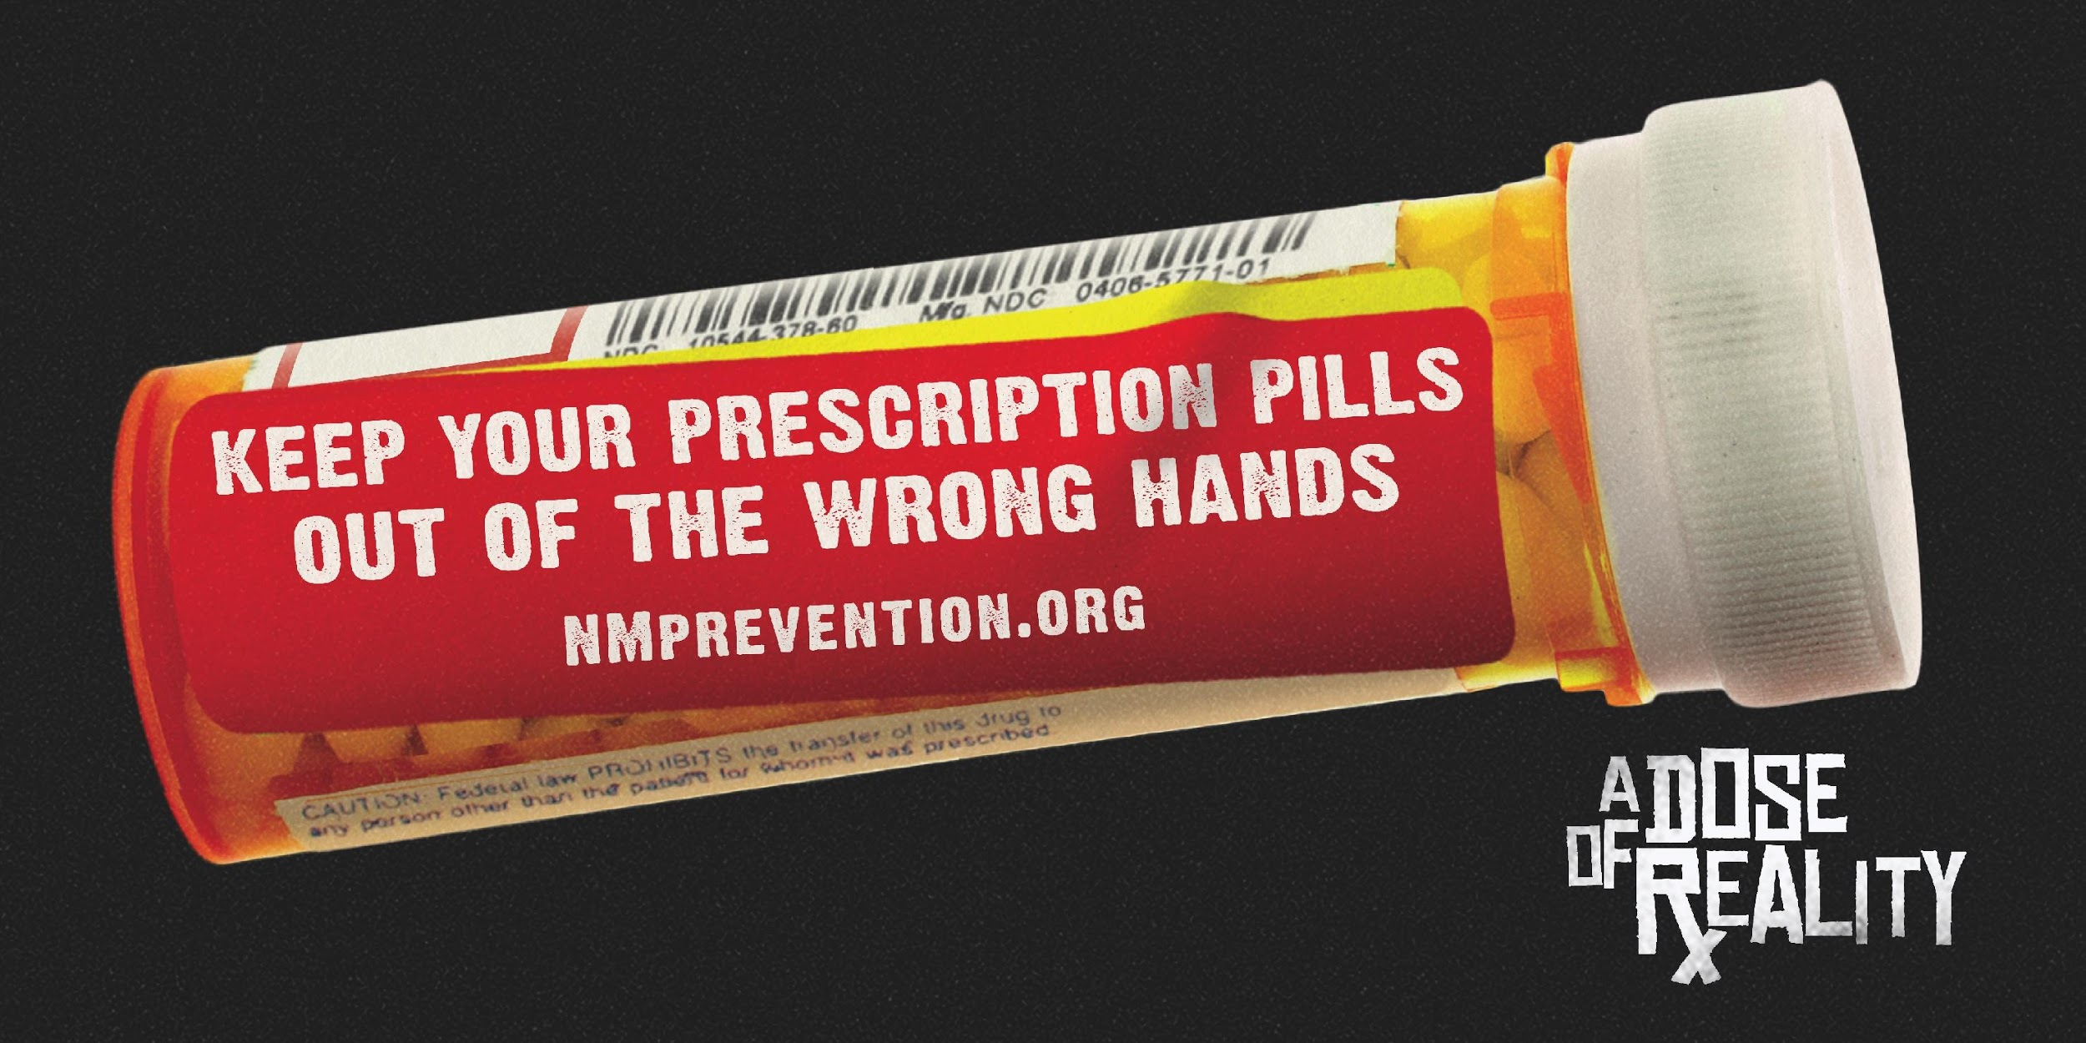
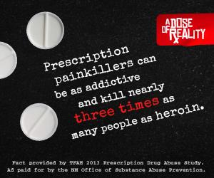
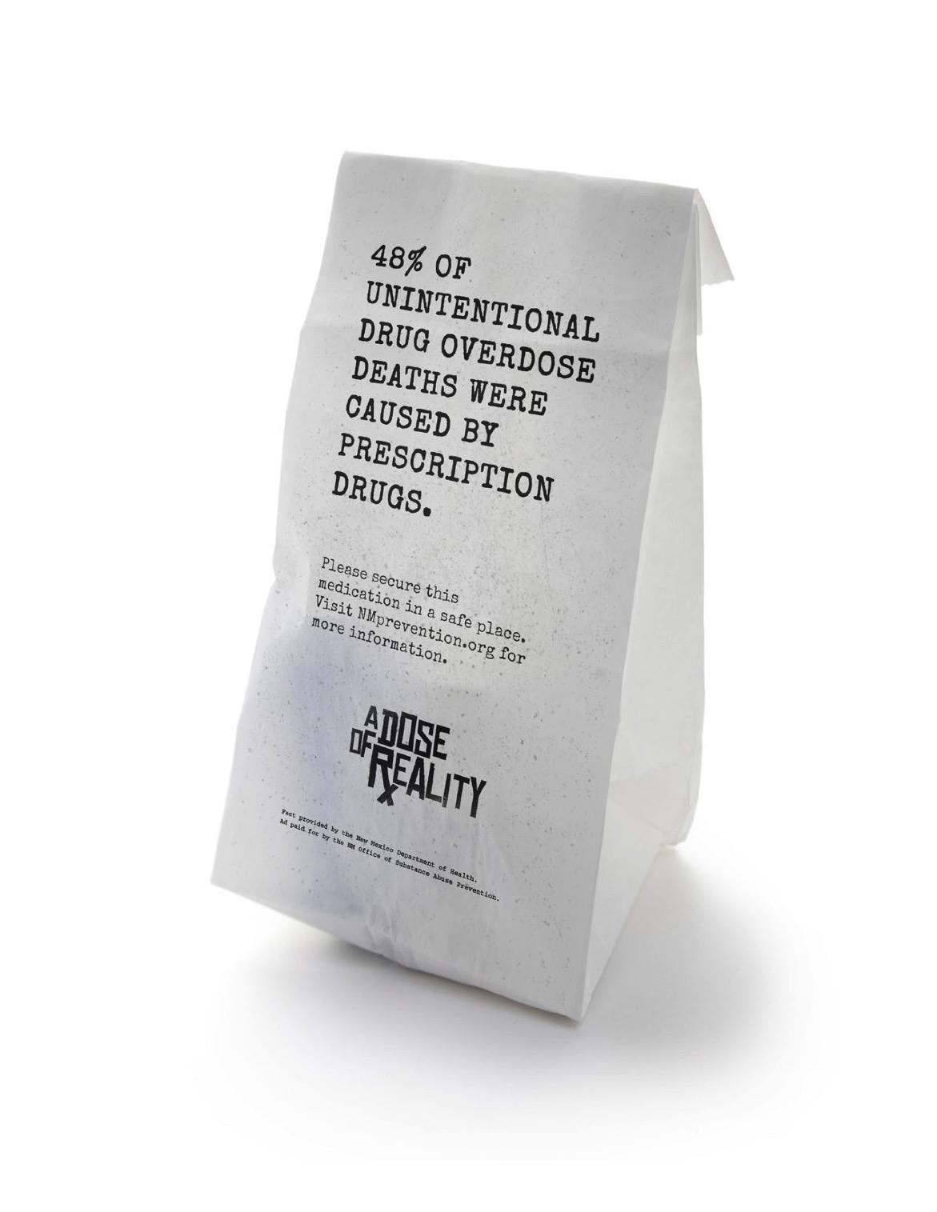
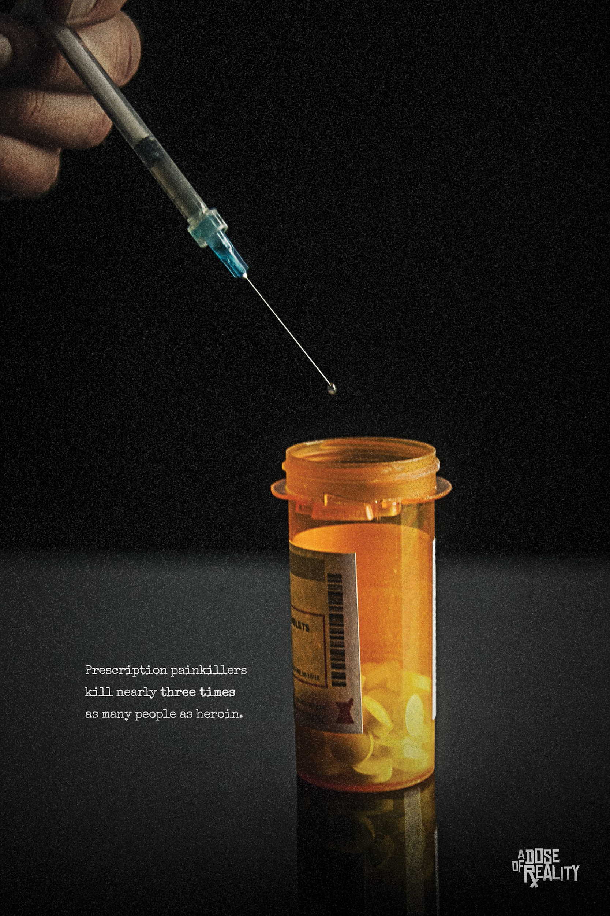
Changing the Misperception of the Dangers Associated with Prescription Painkillers.
Notes:
Social Access
• Target parents to restrict social access • Restrict access through the elderly (locking up meds, using lock and drop boxes, not sharing meds, etc.) • Use media resources to increase awareness of Rx painkiller harm & addiction potential & increase awarenessof dangers of sharing, how to store and dispose Rx safely
Two videos that address the dangers and numerous downloads, including posters, prescription pharmacy bag, ads, etc.

Slide 9
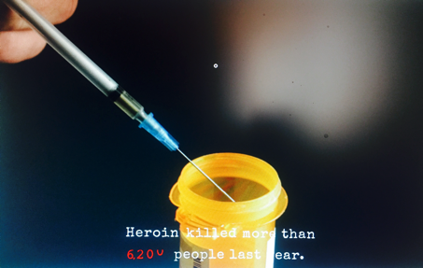
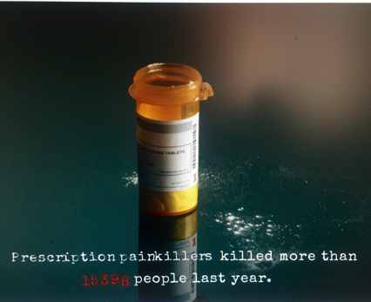
More...

Slide 10
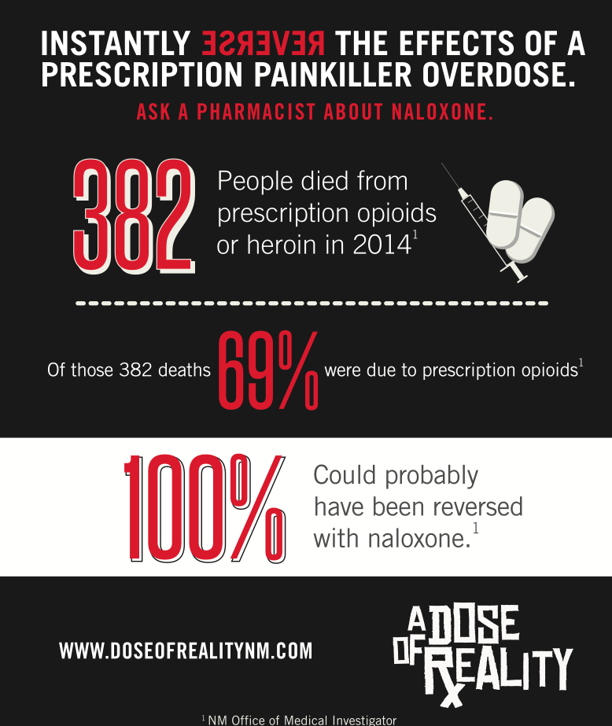
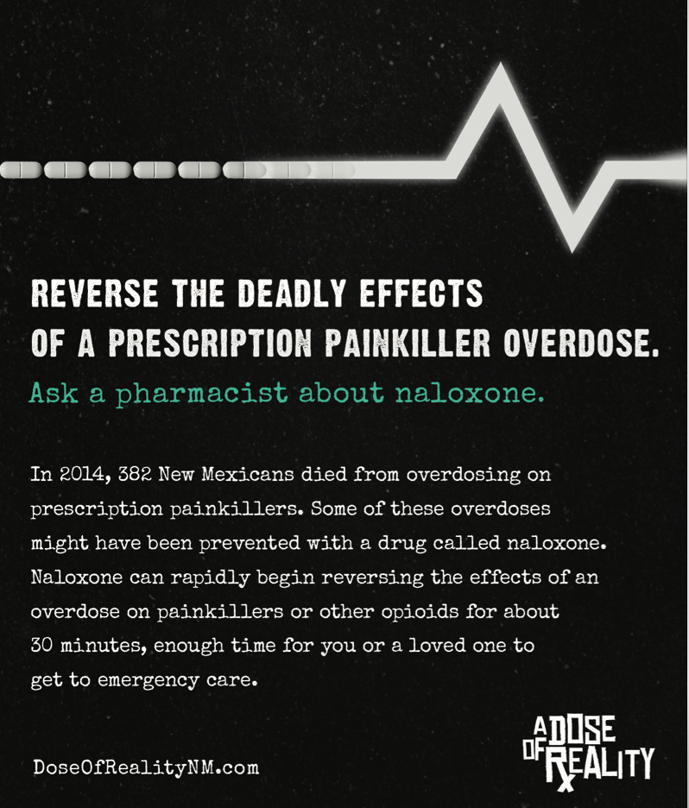
Notes:
Work with pharmacies/medical providers to directly encourage/educate customers•Then we began to address naloxone with Ask a Pharmacist and a pharmacy training program. Doseofrealitynm.com microsite to hold videos Ask your pharmacists - not if they are not trained. So an entire campaign to train them.

Slide 11
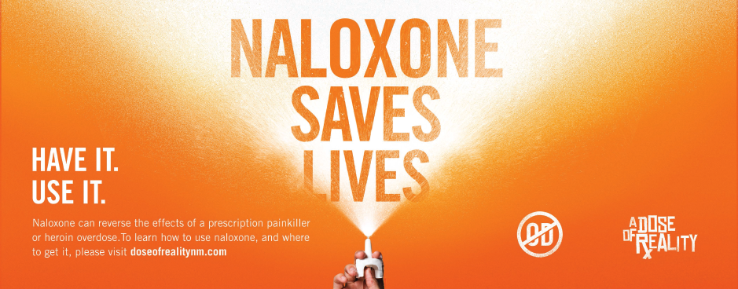

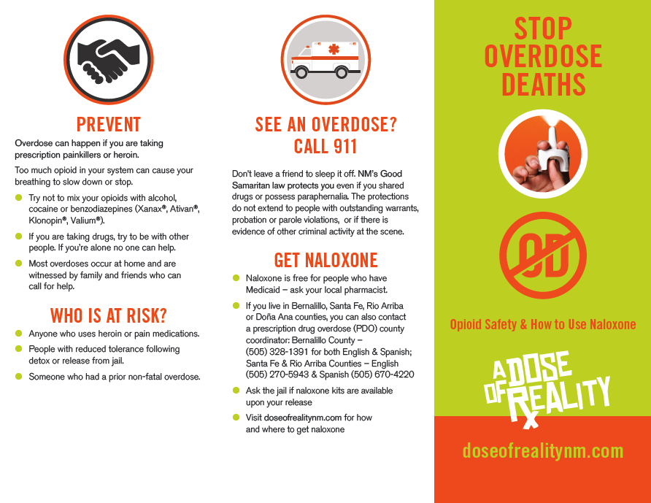
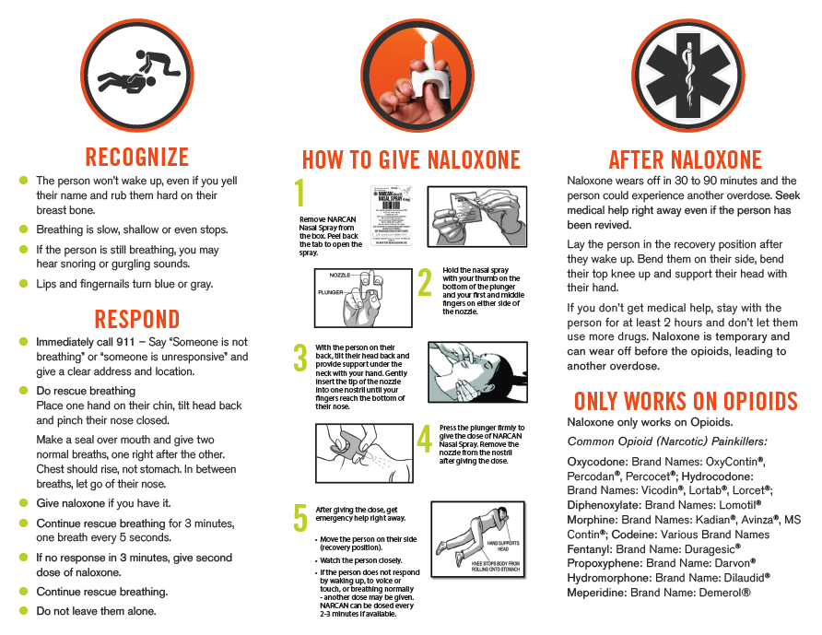
Notes:
Education about naloxone Increasing access to naloxone Education on opioid overdose symptoms Opioid overdose prevention education Reducing stigma around overdose events and need for naloxone Education on the NM Good Samaritan Laws We are all first responders Accessing treatment and recovery support services Education about dangers of sharing medicine
• Prescriber awareness of risky prescribing practices and purchase &
distribution
We how have how to prevent, recognize and respond to an overdose. This is for an interior bus. Posters, brochures, some specific to jails adn correction. We are currently waiting on the final production of two mini ad campaigns “1 in 4” and “maze”

Slide 12
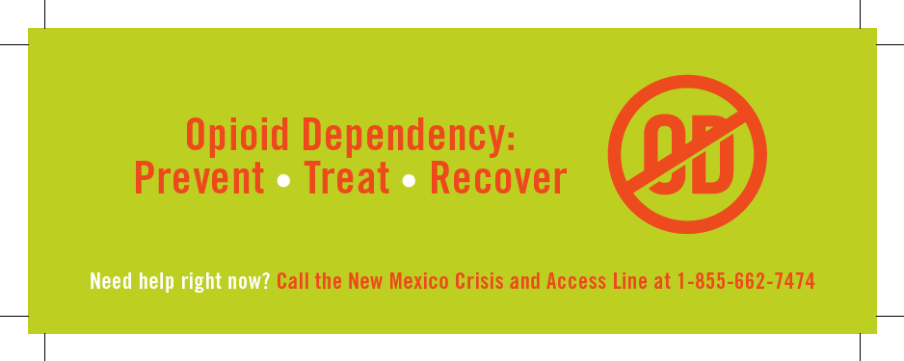

Notes:
Bookmarks and business card leave behinds for your community.

Slide 13
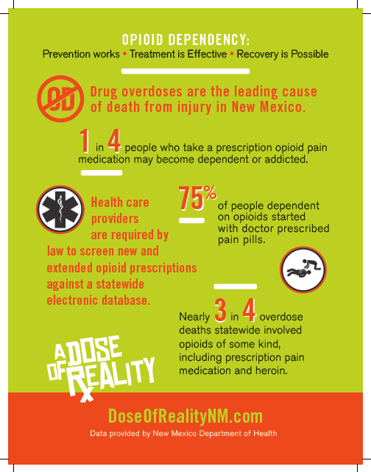
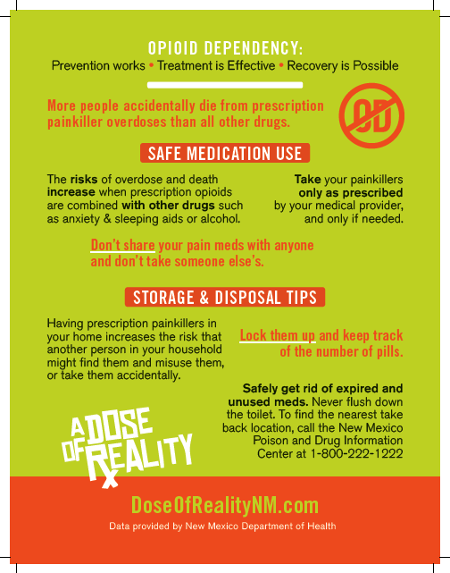

Slide 14
Samples of Resources Available
:30 PSA
Here’s a dose of reality. More people die from prescription painkiller overdoses than all other drugs and one in four people become addicted to prescription opioid painkillers. Take your painkillers only as prescribed by your medical provider. Don’t share your pain meds with anyone and don’t take someone else’s. Lock them up. Keep track of the number of pills. Safely get rid of expired and unused pain meds. Remember, the risks of overdose and death increase when prescription opioids are combined with other drugs or alcohol. DoseOfRealityNM.com
https://vimeo.com/album/5004430

Slide 15

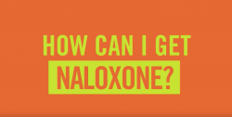
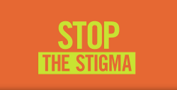
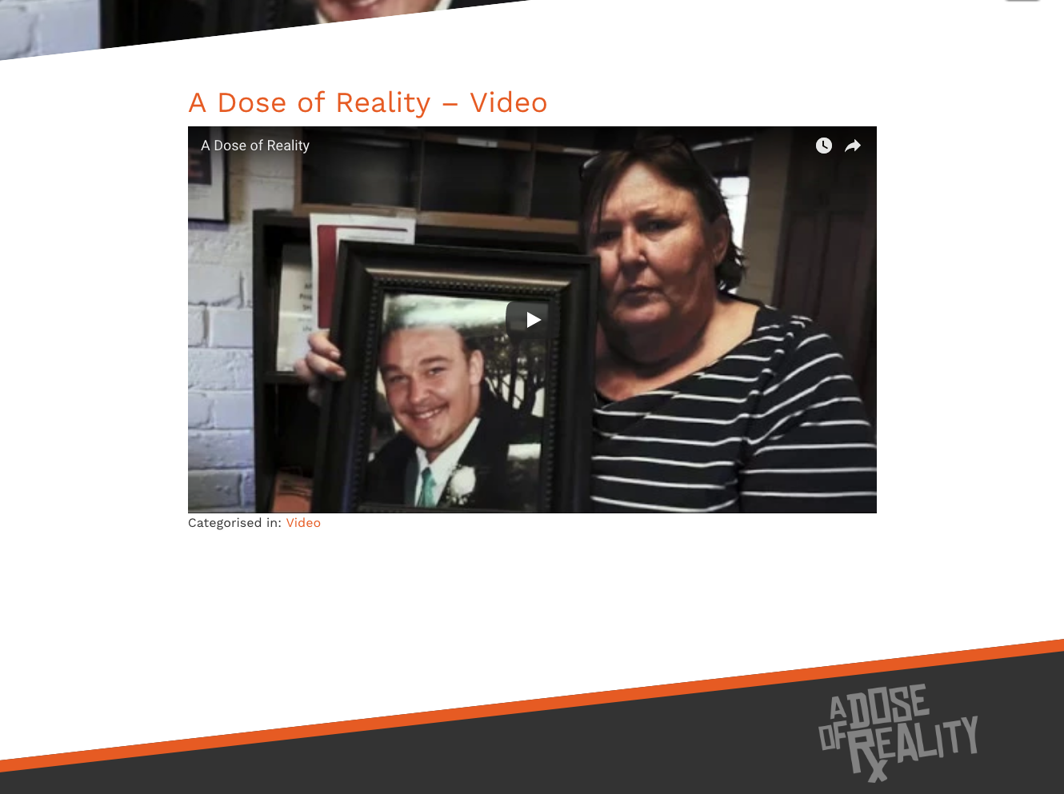
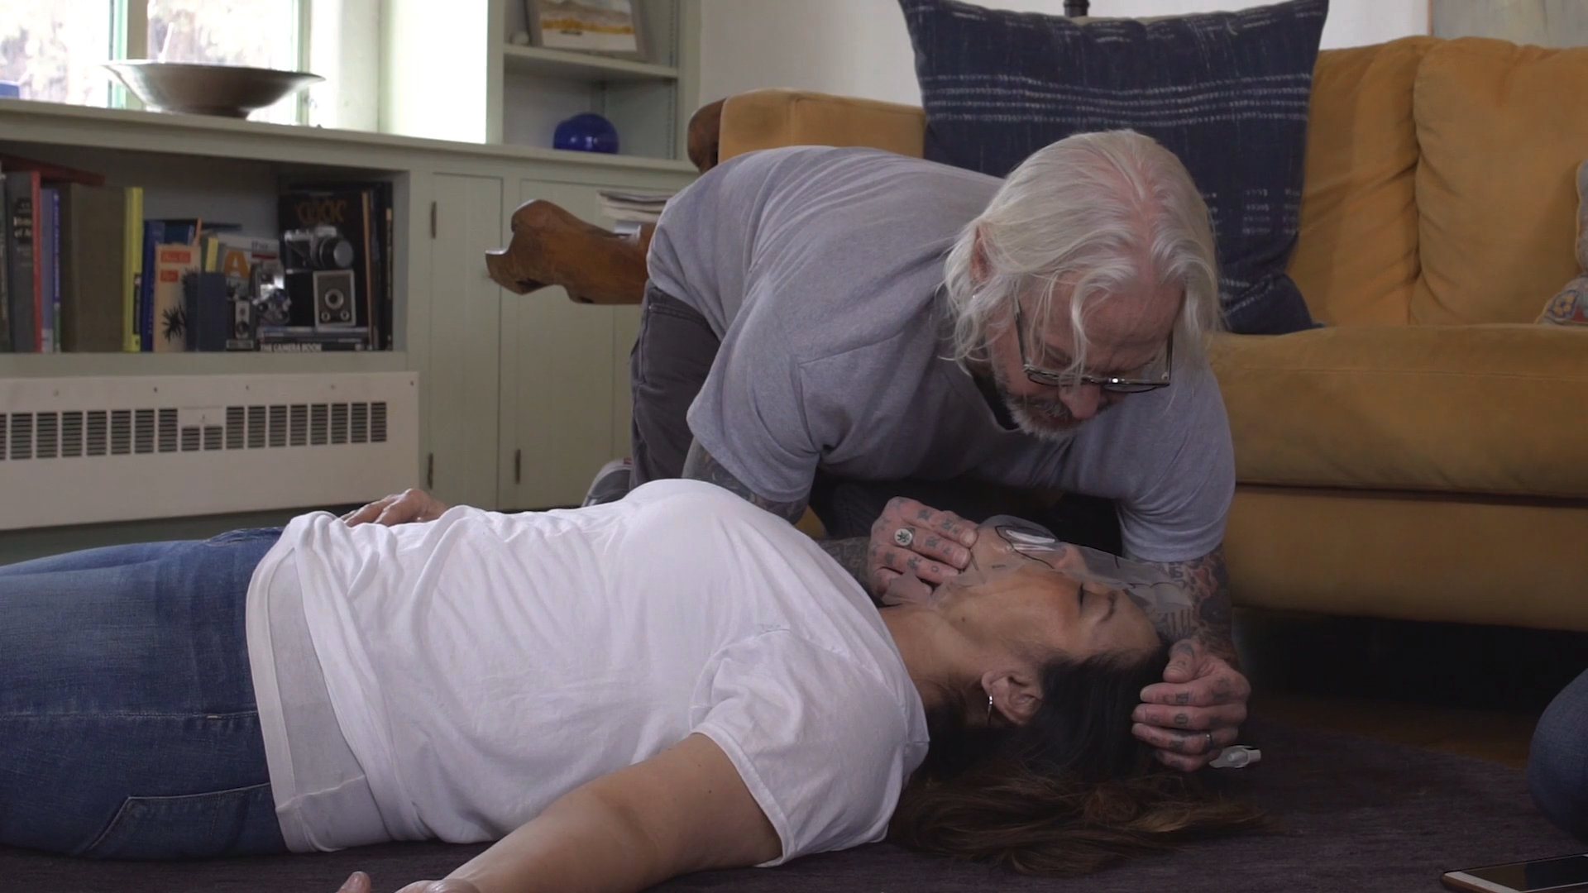
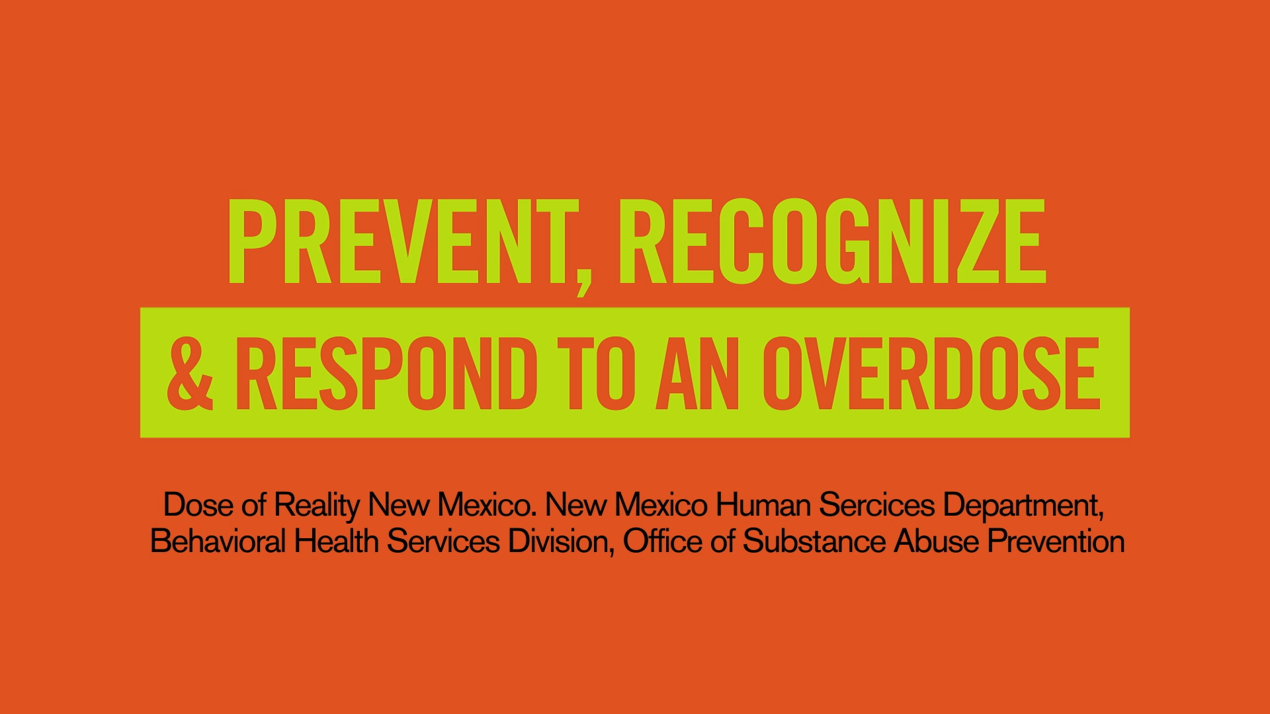
Videos

Slide 16

A Dose of Reality
Website & Social Media

Slide 17
www.doseofrealitynm.com
Notes:
Develop a New Mexico community website that will provide current information and education about naloxone, harm reduction, safety planning, tips for families, naloxone reimbursement, pharmacy access,
opioid reversals, dangers of sharing opioids, importance of adequate
storage, how to get naloxone for the individual, organization/agency,
treatment resources, counseling and MAT and Hep C, syringe exchange,
harm reduction services.

Slide 18
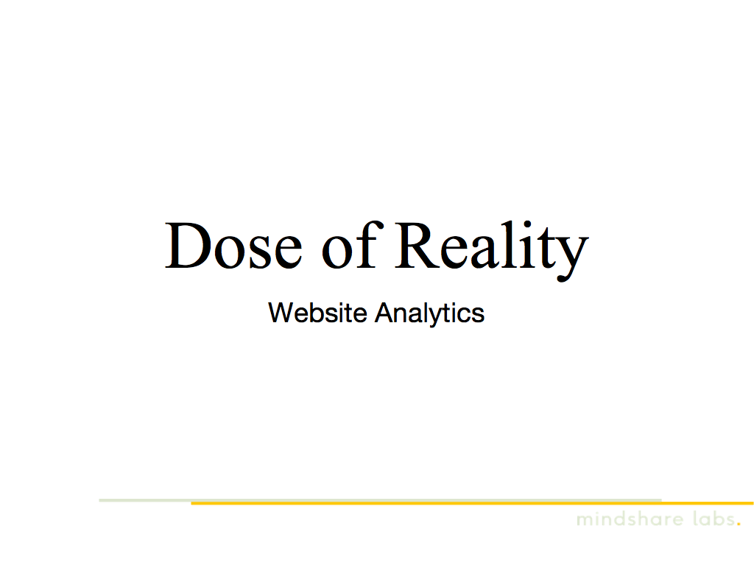
Notes:
While there are numerous government and community websites that include opioid prevention, harm reduction, treatment and recovery, there was not a singular stand-alone, one stop source for English and Spanish speaking members. This year, the Dose of Reality NM .com website become the cornerstone of our campaign. All advertising and social media and other outreach will have CALL to ACTION to visit website.

Slide 19
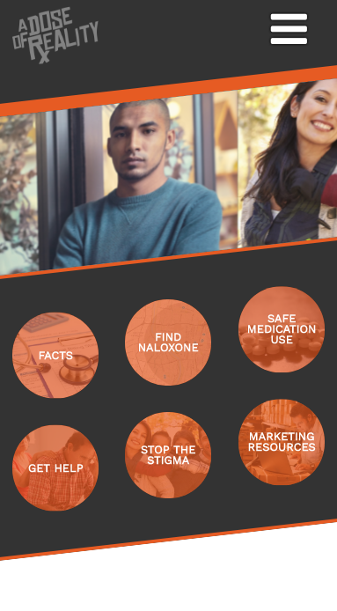
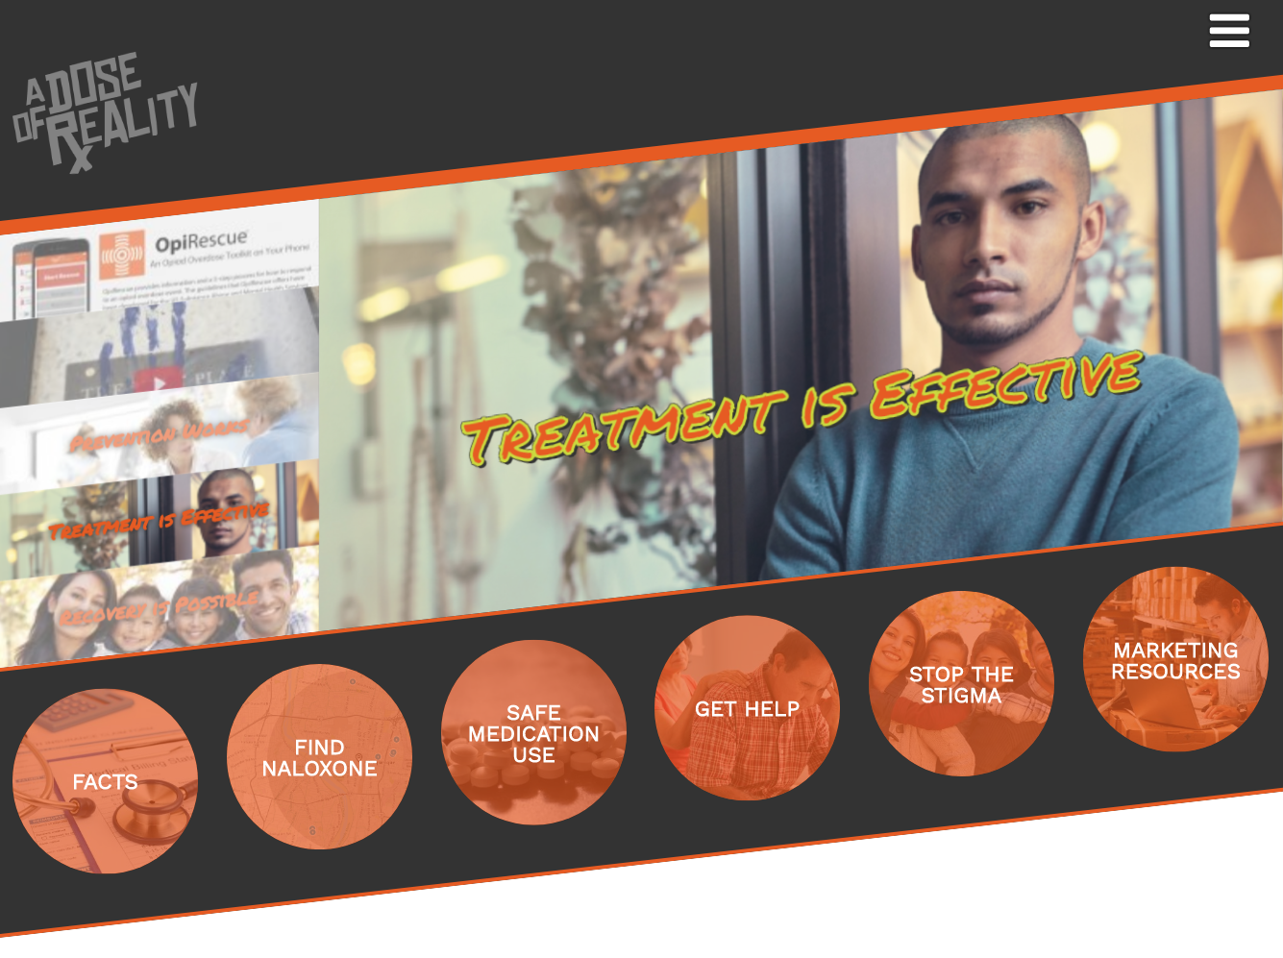
Website Features and Development
Mobile Version
Desktop/Tablet Version
Notes:
Responsive on mobile and desktop/tablet and Easy Navigation with integrated Search Engine Optimization. So how are we doing? Comparing to national social issues and advocacy benchmarks, we have 50% more visitors from social media compared to national average and 35% more visitors from direct traffic (typing in url) and people spend 36% more time on the site than the national average and visit more pages. Get help and Fina naloxone are top two landing pages visited.

Slide 20
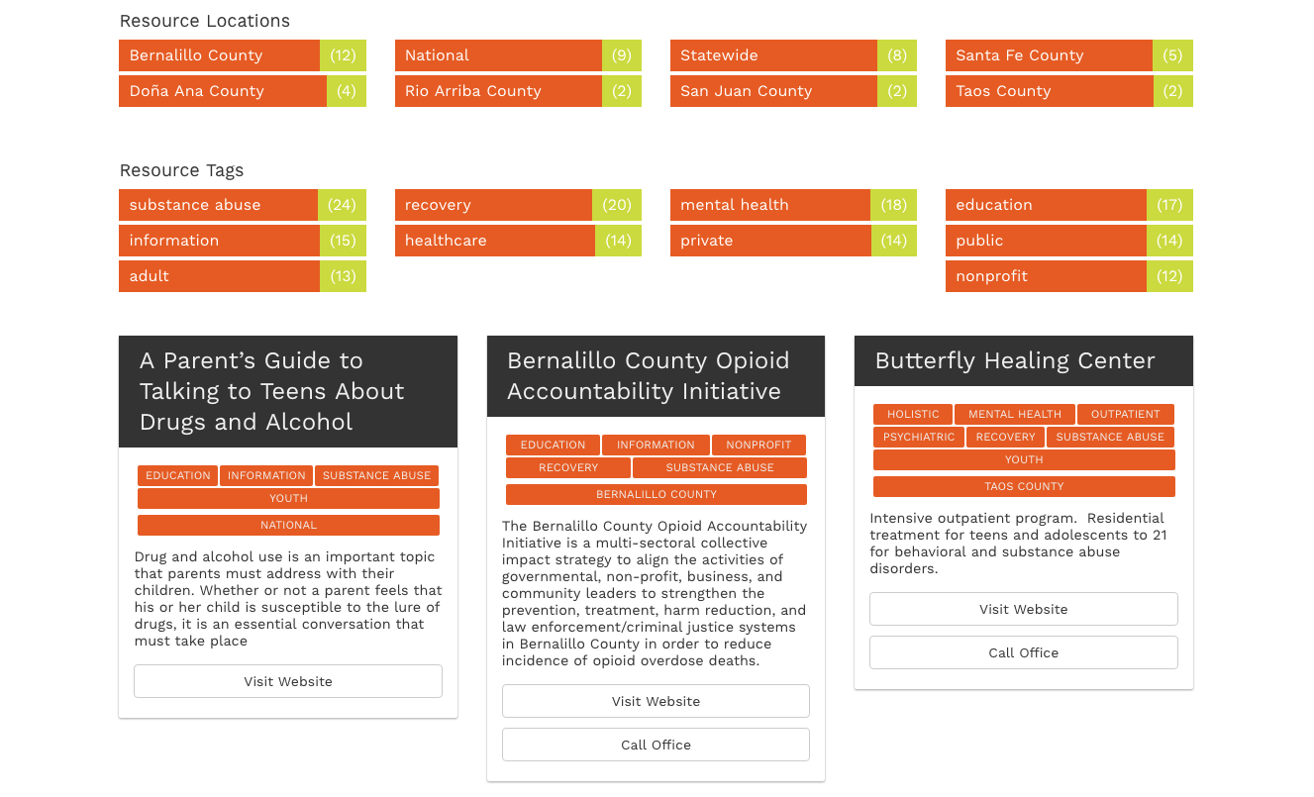
Website Features and Development
Sorting and Filtering for all Resources
Marketing/Promotional & “Get Help” Resources
Notes:
It took several months to gather all required information, draft messaging, get approval, design and organize. Now, we are fine-tuning it based on analytics we constantly review and feedback.

Slide 21
Website Features and Development
Video Embedding and Playing
(Desktop & Mobile)

Slide 22
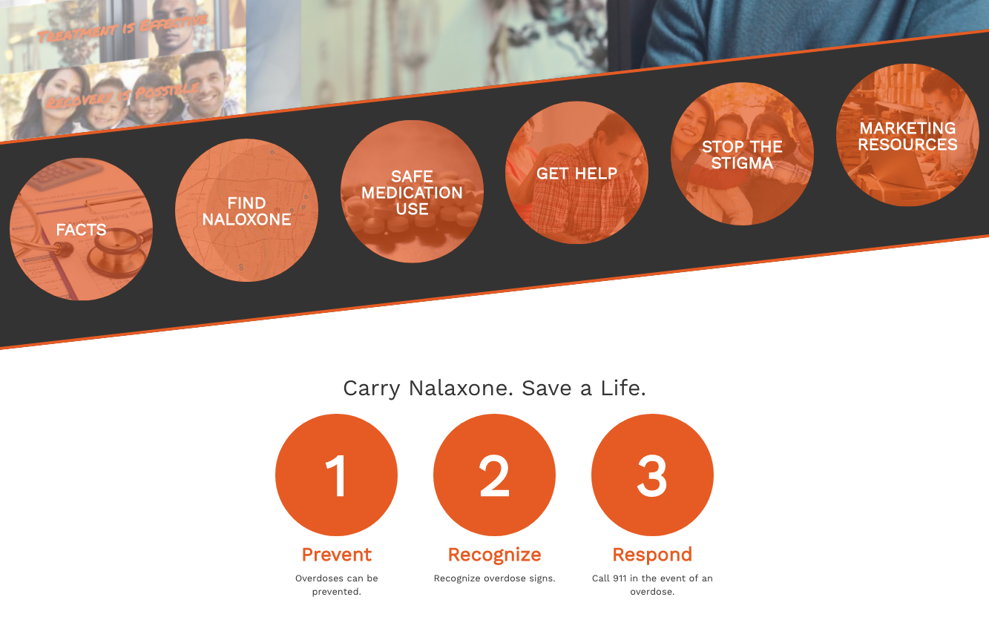
Website Features and Development
Easy to edit & configure in-page navigation elements.
(Basically, navigation as part of the content.)
Notes:
Navigation as part of the content

Slide 23
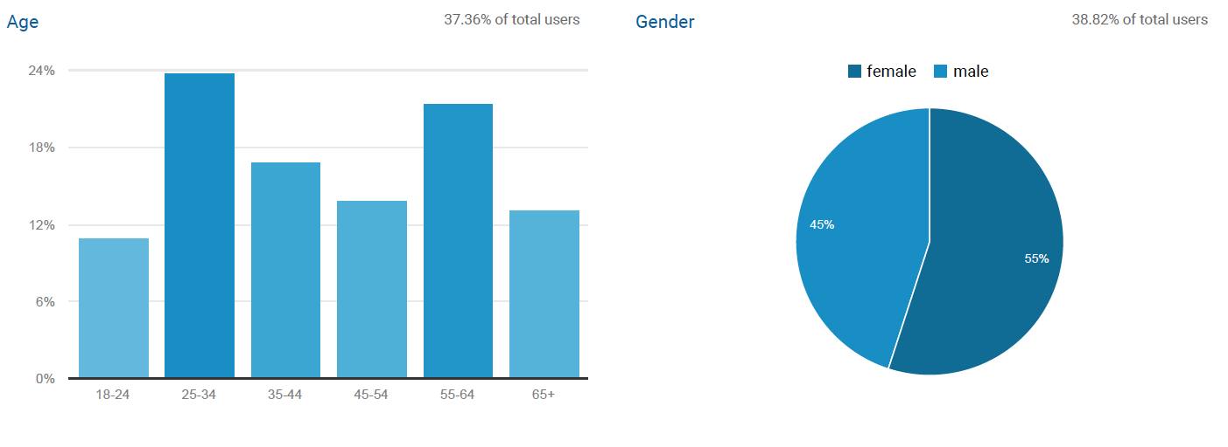
Who are our visitors?
Age
Gender

Slide 24
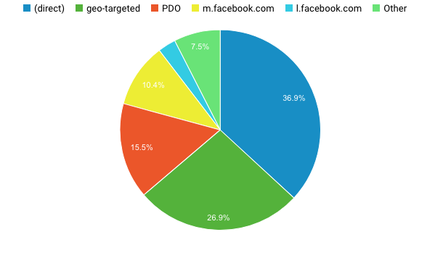
Where do they come from?
Traffic Sources

Slide 25
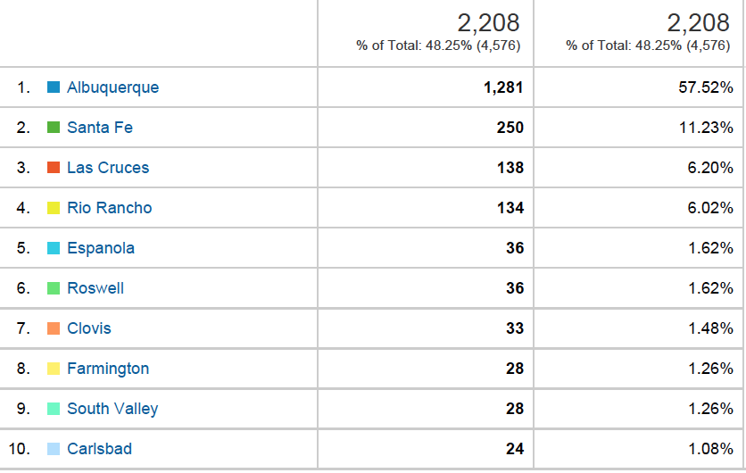
Who are our visitors?
Location Table

Slide 26
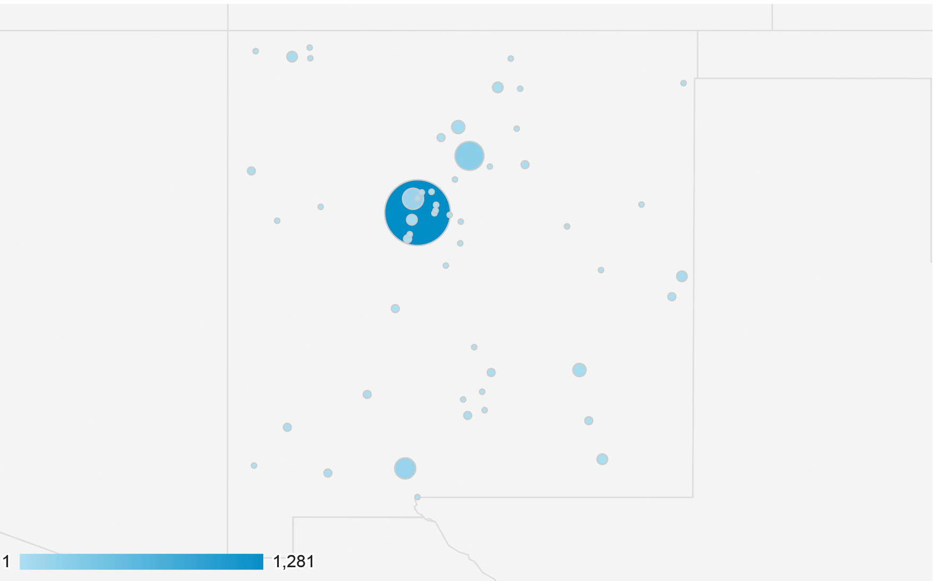
Who are our visitors?
Location

Slide 27
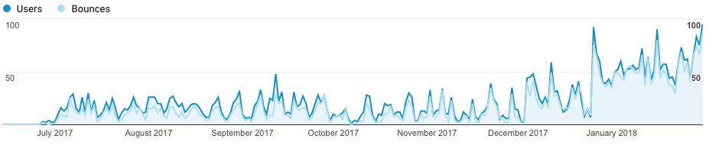
What are they doing?
Users and Bounces
Organic Search Bounce Rate:
Social Bounce Rate:
Advertising Bounce Rate:
Average Site Bounce Rate:
32%
76%
92%
74%
Notes:
We want to be around 55-60% Also, we are now tracking if people are leaving the site and going to an outside link such as get help.

Slide 28
Next Steps and Suggestions
Clarify Page Purposes
  What do users expect to find?
  What are users looking for?
Track Outbound Links
  What resources (if any) are users taking advantage of?
  Is our bounce rate actually that high?
Continue Site Improvements
  Content resource organization
  Site usability
  Landing page usability and draw
  Campaign specific landing pages

Slide 29

@doseofrealitynm
#doseofrealitynm
Social Media Reporting
June 1, 2017 - January 31, 2018

Slide 30
Social Media Objectives
Awareness about the following:
● Dangers of sharing medications
● Safe storage and disposal
● Risks of over prescribing to young adults
● Availability of and access to Naloxone (minimal, but is in contract)
Social Media Platforms @doseofrealitynm
● Facebook
● Instagram
● Snapchat

Slide 31
Hashtag
Campaign hashtag #DoseofRealityNM
We “own” this hashtag as it hasn’t been used on Facebook or Instagram
Topic specific hashtags
#DangersofSharing
#SafeStorage
#PrescriptionRisk
#GetNalaxone

Slide 32
SHARE CONTENT AND EXPANDING YOUR REACH
Photographs
Videos
Articles
Cross-promotion - Ask friends/followers to share and promote
SEND TO: hello@simplesocialmedianm.com
Notes:
Tag us and follow us and we will follow you and share your information to better improve your reach. AND THE FOLLOWING WILL TELL YOU WHY THAT IS IMPORTANT
Encourage social media sharing among adults 18+ who are some of the most active users of these social networks.
Create a distinct section on our ADOR website to educate and encourage discussion.
Utilize real stories in our social and PR campaigns to bring a "human element" to the advertising messaging.
Engage with social media influencers to create content that will positively impact our target via social media, where they rely on influencers for their information and opinions.
Perception of harm and sharing of Rx opioids
Proper and safe storage of Rx opioids
Harm risk of Rx opioid misuse, abuse among youth, parents, and young adults
Audiences: Anyone at risk of overdose, first responders (all) and organizations that work with addiction

Slide 33
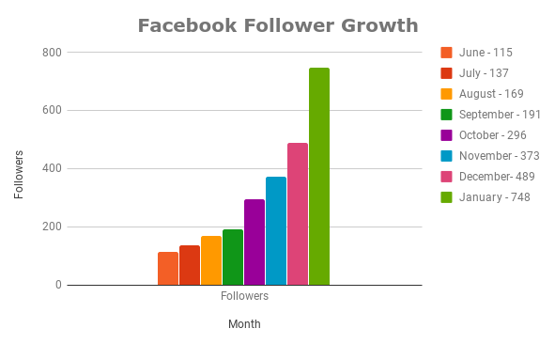
@doseofrealitynm - Facebook
June 1, 2017- January 31, 2018

Slide 34
@doseofrealitynm Follower Base
June 1, 2017 - January 31, 2018
Facebook Followers: (748) / Fans (729)
  Reach: (195,900)
  Engagement: (5,517)
Instagram Followers: (227)
  Reach: (31,196)
  Engagement: (2,241)
Notes:
It’s not just how many followers you have, it’s about who you are reaching and if they are engaging.

Slide 35
Target Location and Demographic
Location:
New Mexico
Demographics:
13 - 65+
Women & Men
Job and/or Field of Study Keywords:
Parents, Social Worker, Therapist, Pharmacist, Police Officer, Firefighter, Emergency Room Nurse & Doctor, Health Care & Home Service, Firefighter, Construction, Substance Abuse and Mental Health Service, Cook, Waiter, Alcohol and Drug Counselor, Middle or High School Counselor, Principal. Middle and High School Teachers, Student, etc...
Interests Keywords:
Intervention, Activism, Rehab, Recovery, Substance Abuse Prevention, Social Justice, Community Issues, Non-Profit, Human Rights, Social Issues, Middle and High School, Detox, Charitable Organization, Volunteering, Drug Education, Residential Treatment, etc...
Life Event:
Away from Family, Away from Hometown
Notes:
We have the ability to share your posts directly within your community with zip code, any demographic, jobs, interests keywords But we can’t do that unless you provide us with what you need. You will also have the ability to extend your reach through paid boosts that can range from $5 on up.

Slide 36
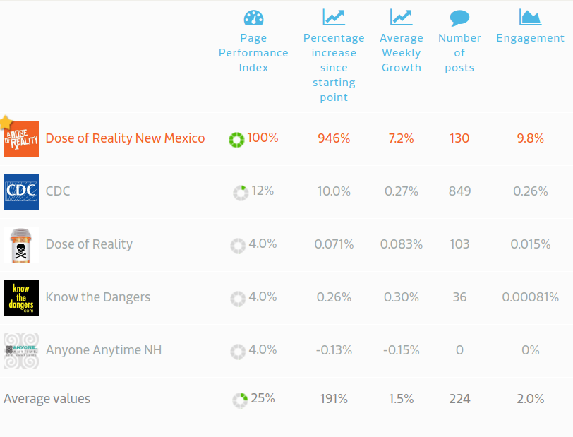
@doseofrealitynm - Facebook Growth Comparison
June 1, 2017- January 31, 2018
The Page Performance Index (PPI) is a combination of engagement and growth. It combines both figures to provide an estimate value for a pages success and is based on the average growth and engagement values of all pages in our index.

Slide 37
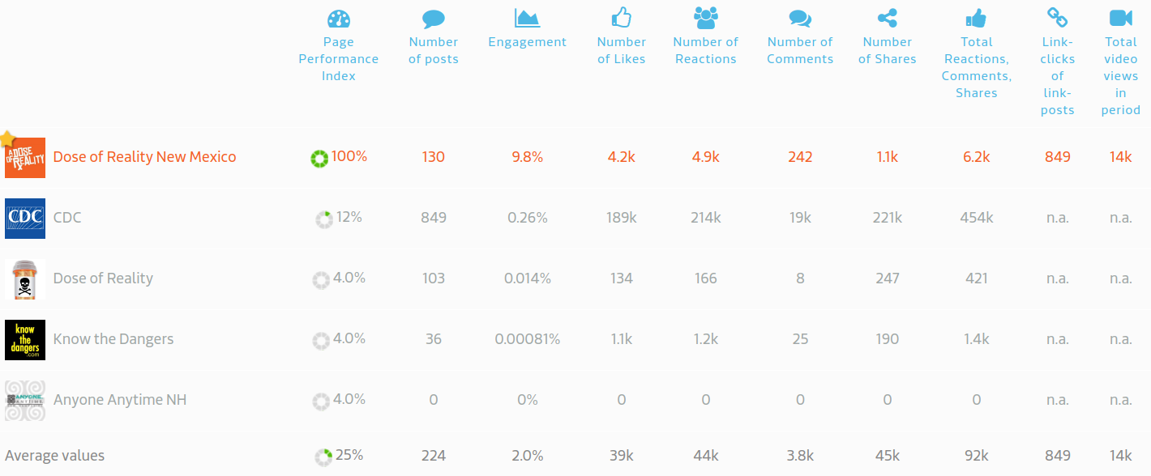
@doseofrealitynm - Facebook Post Comparison
June 1, 2017- January 31, 2018

Slide 38
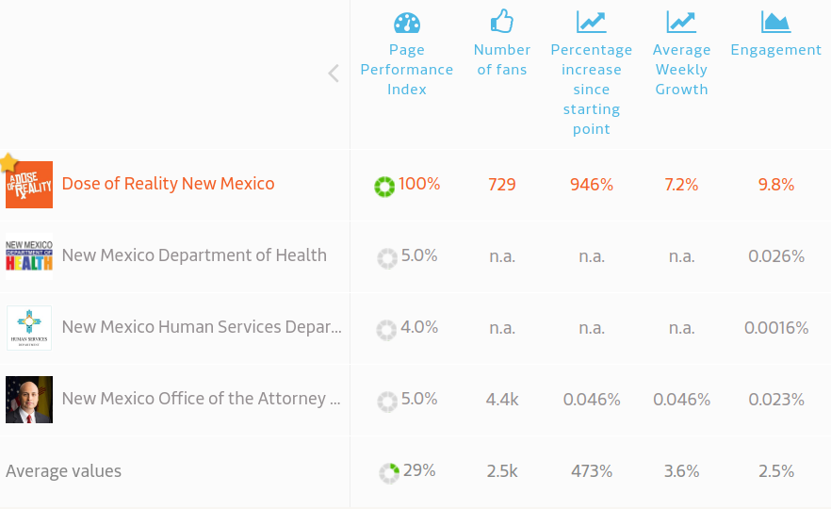
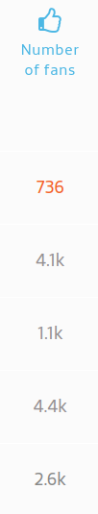
@doseofrealitynm - Facebook Growth Comparison
June 1, 2017- January 31, 2018
The Page Performance Index (PPI) is a combination of engagement and growth. It combines both figures to provide an estimate value for a pages success and is based on the average growth and engagement values of all pages in our index.

Slide 39
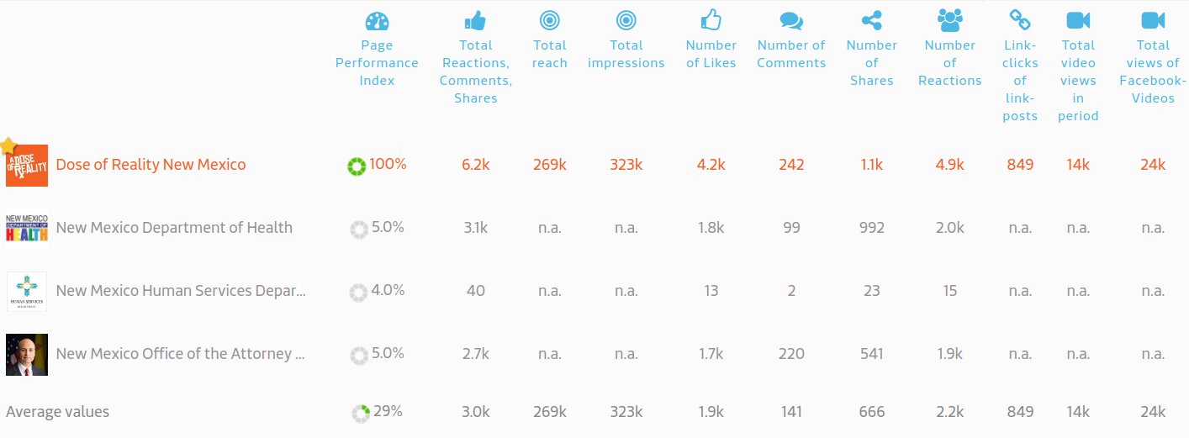
@doseofrealitynm - Facebook Post Comparison
June 1, 2017- January 31, 2018

Slide 40
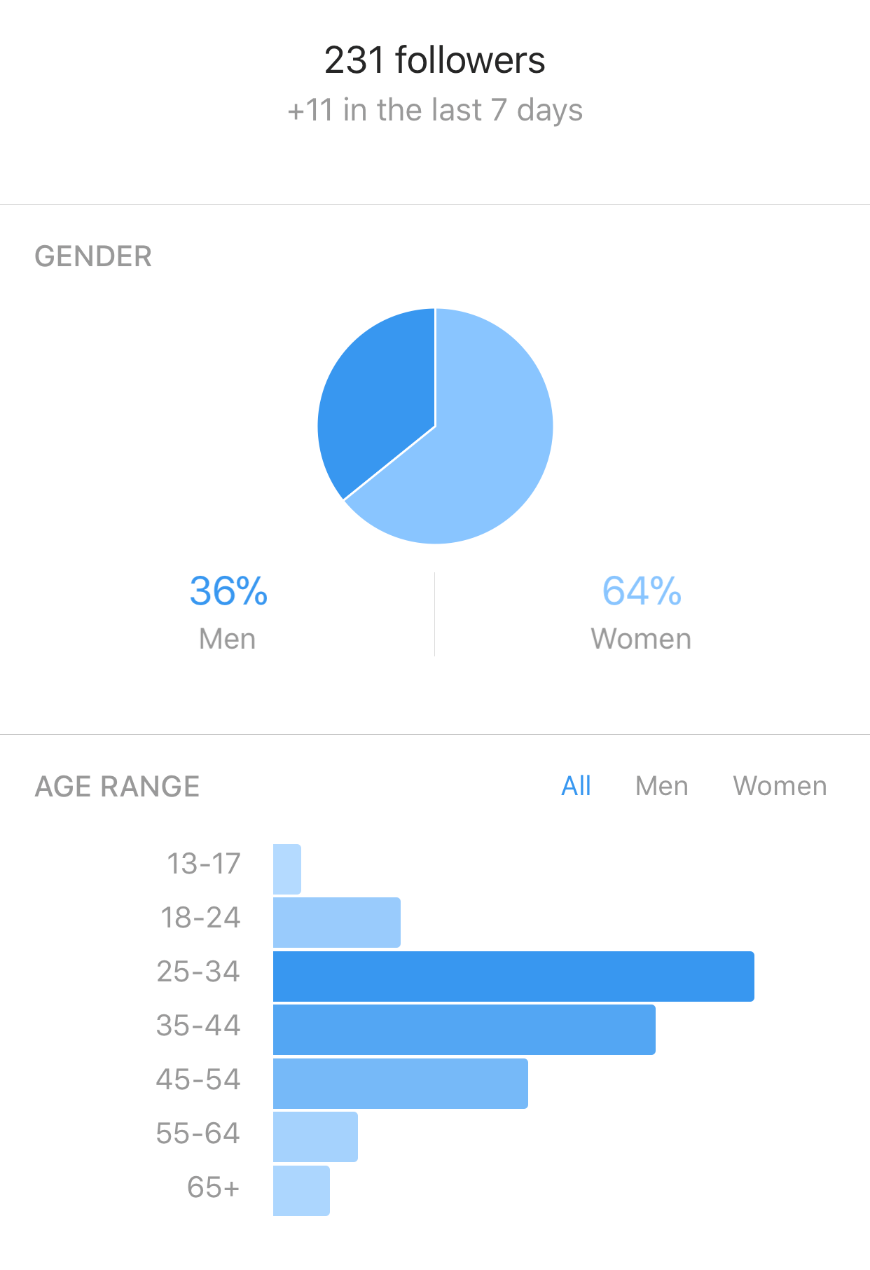
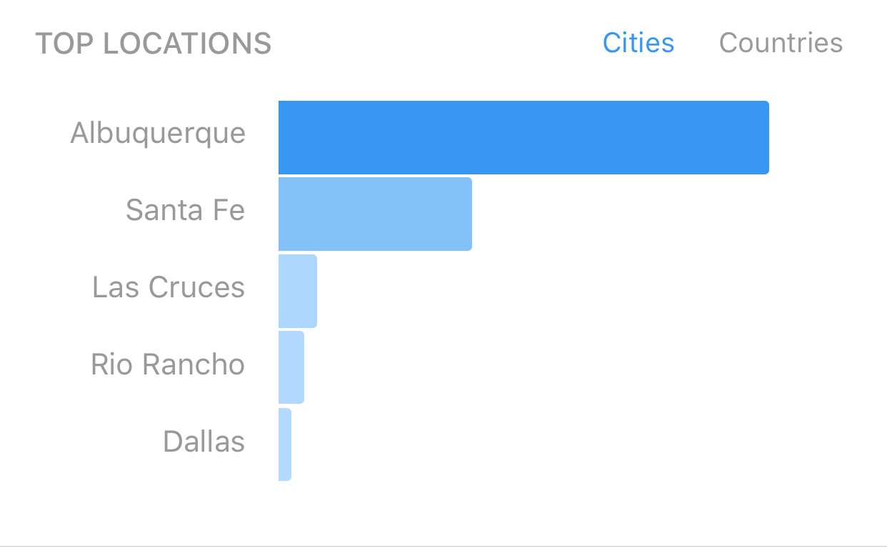
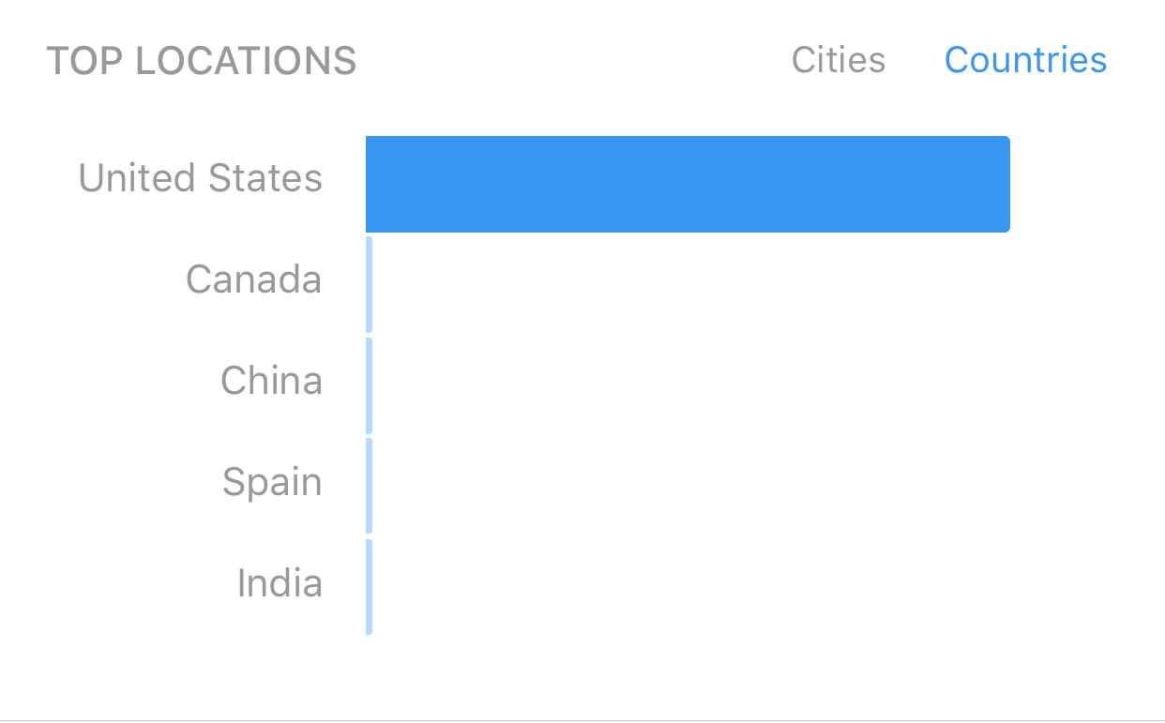
Instagram Page Demographics

Slide 41
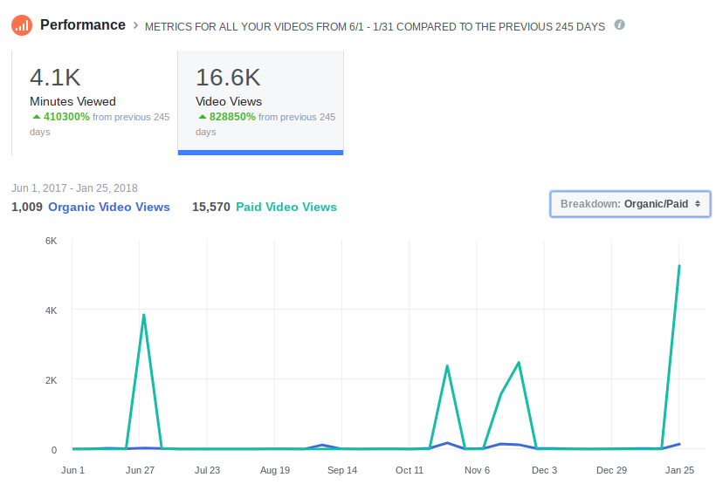
Facebook Video Views
June 1, 2017 - January 31, 2018
Notes:
Go to website and SHOW Helen Video

Slide 42
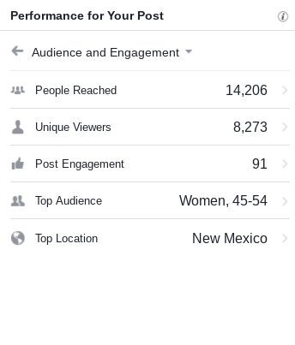
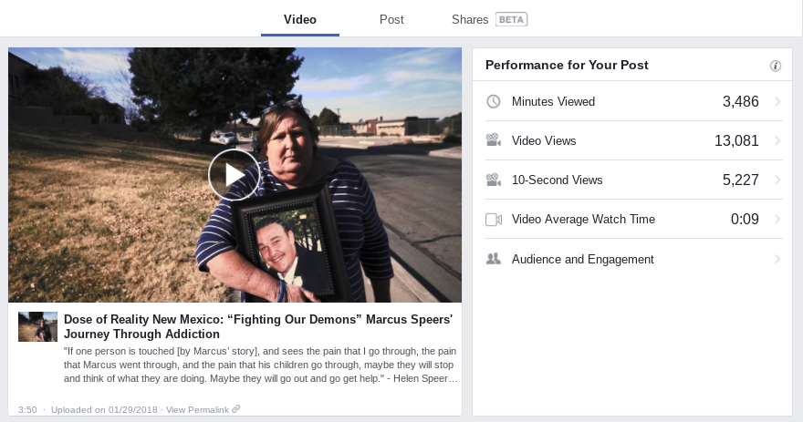
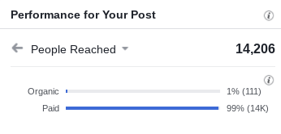
Humans of New Mexico Video
Helen Speers

Slide 43
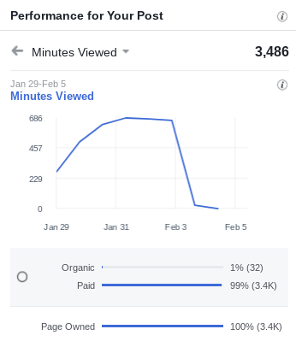
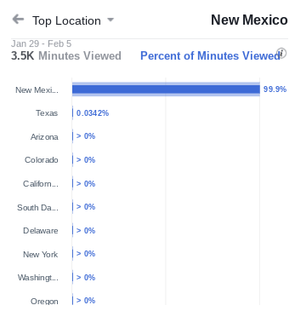
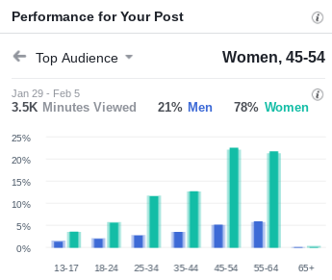

Slide 44
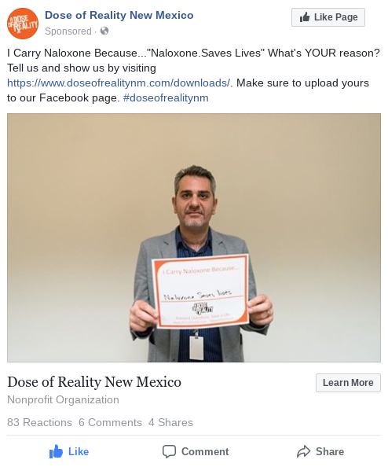

I Carry Naloxone Because....

Slide 45
Humans of New Mexico Micro-Influencer Testimonial Collection Collaboration
What is a micro-influencer? Micro influencers are creators on social media platforms who typically have between 1,000 and 100,000 followers. These creators typically build followings around niches like travel, fashion, beauty and photography, and cultivate communities surrounding their content. Many of them interact with fans and followers regularly and, as a result, micro influencers may sometimes see high engagement and active audiences.
Portraits of people in their environment who are currently or potentially affected by opioid usage including why these issues are important to them. Person in recovery (and OSAP recovery expert). Senior with multiple prescriptions, Parent, Survivor of accidental overdose, Harm reduction specialist, Overdose witness (first responder significant other or family member). Pain management patient
Capture these stories through still imagery, video, audio, and text.
Physical exhibit of imagery and stories with opening reception to connect to community members.
Notes:
Testimonial
Portraits of people in their environment. who are currently or potentially affected by opioid usage including testimonials about why these issues are important to them.

Slide 46
Social Media Ad Spend
June 1, 2017 - January 31, 2018
Facebook $2,626.25
Instagram $215.00
Snapchat Geo-Filter $447.67
Influencer Accounts (HNM) $175.00
Total $3,463.92* *Non-advertising budget
Notes:
Snapchat geo filter was a #failure, but we are not giving up on it. We geared it toward UNM and need to experiment with days of week and time. Neighborhoods. *Geofilters – Location based marketing
Geo filters on Snapchat, specifically targeted to geolocations/areas that are affected such as schools, universities, nightlife neighborhoods, sport centers, hospitals, clinics, high risk neighborhoods, etc. Businesses and organizations can purchase On-Demand Geofilters for a specific location.

Slide 47
Humans of New Mexico Micro-Influencer Storytelling Collaboration
Facebook Followers: (5,546) / Fans (5,450)
  Reach: (35,936)
  Engagement: (2,821)
Instagram Followers: (2,525)
  Reach: (13,523)
  Engagement: (1,139)

Slide 48
Recommendations
Expand the “I Carry Campaign”.
“Community Spotlight” of grant recipients & other organizations doing similar work.
Social Media Toolkit to share with grant recipients as well as other partners such as NM Humans Services, NMDOH, MCOs, and NM Attorney General’s Office.
Expand project with Humans of New Mexico to other areas of NM, especially rural and traditionally underserved communities.
  Broaden that partnership to reach out to grant recipients, treatment facilities, etc. to help find potential interviews and collaborative partners.
Actively solicit online testimony.
Increase Ad Spend via share of ad budget on Facebook and Instagram.

Slide 49
Recent Grant Recipient Requests
:30 radio spot and script
Revise a bus wrap
Provide a general infographic
Provide a safe medication use infographic
Review marketing plan for input
How to split ad budget with different media buys (radio, FB, IG, print, etc.)
How to negotiate when purchasing an ad
How to know if an ad will reach your target
How do you target a particular reporter and pitch a story

Slide 50
FY19 Suggestions
Community Outreach Kit - targeted to grant recipient communities and anyone to encourage parent groups, educators, coaches, businesses, faith groups, law enforcement, service organizations, medical community to hold DOSE OF REALITY EVENTS branded events.
All materials on website and can be used for free (not printing or media buy). Instructions on how to use the kit, talking points, fact sheets, social media posts to use, PPT Presentation, E/S PSA scripts, flyers, posters, brochures, logo, etc.
General Tools - More generalized (not advertising message) to support grant recipients on topic specific for general use with call to action to DoseOfReality.com
Add Tagline to Logo - to better identify purpose (opioid prevention, recovery, treatment (MAT).
Ad $ for Social Media - share of ad budget to do social media advertising.
Notes:
$43k on ads so far and have only 1200 visitors with a bounce rate of 90% and less than ten seconds on the site. We have received the same amount of visitors from direct and social without paying. Does not take into account impressions (those who may have seen it) but we need to review how to improve these, as well as look at advertising more on social, which is having less bounce rate and people staying longer.

Slide 51
What do you need in a Community Toolkit?
Social Media Toolkit - what would that look like?
Fact sheets (localized?)
Revised parent resource kit
News Media Tips
Ad Buy Tips
Infographics
Posters
Notes:
Presentations, talking points, story ideas, etc. What are the most common things you do for outreach? What about the website can we improve to help your communities?

Slide 52
Questions?
lynn@pkpublicrelaations.com

